Slide 1

An Online Photograph Application:
Web Design/User Experience- INFO6150, Fall 2018, Northeastern University
Dev Mukherji | Haozhong duan | Ruimin Feng | xin luo | Yiqian feng | yumeng wang

Slide 2
User Stories
Domain Driven Design Model
Functions and UI
Demonstration

Slide 3
User Stories
As a guest, I should be able to register an account, so that I will be a common user or an advanced user with access to more functions provided by the application.
As a user, I should be able to login and logout my account so that I should be able to view and manipulate under my account.
As a user, I should be able to view some guidelines so that I could easily learn how to better use this application.
As a user, I should be able to apply different filters onto image so that different image styles will be achieved.
As an user, I should be able to resize the image so that I will have no trouble on further image handling.
As a user, I should be able to import and export image files so that I can manipulate the file.
As a common user, I should be able to send a request to Administrator so that I have chance to become an advanced user.
As an advanced user, I should be able to introduce some prestored stickers from picture library so that unique mixed image style can be applied.
As an advanced user, I should be able to import a image and use the key world analysis function so that I can get some keywords that described the image.
As an advanced user, I should be able to type a keyword and search a image so that I can find a wanted image and export it.
As an Administrator, I should be able to upgrade users so that common users can finally become abvanced users.

Slide 4
Our recommendations
1
Admin: view users and upgrade user
2
Common user: add filters, download,
3
Advanced user: add filter, stickers, key world analysis, search

Slide 5
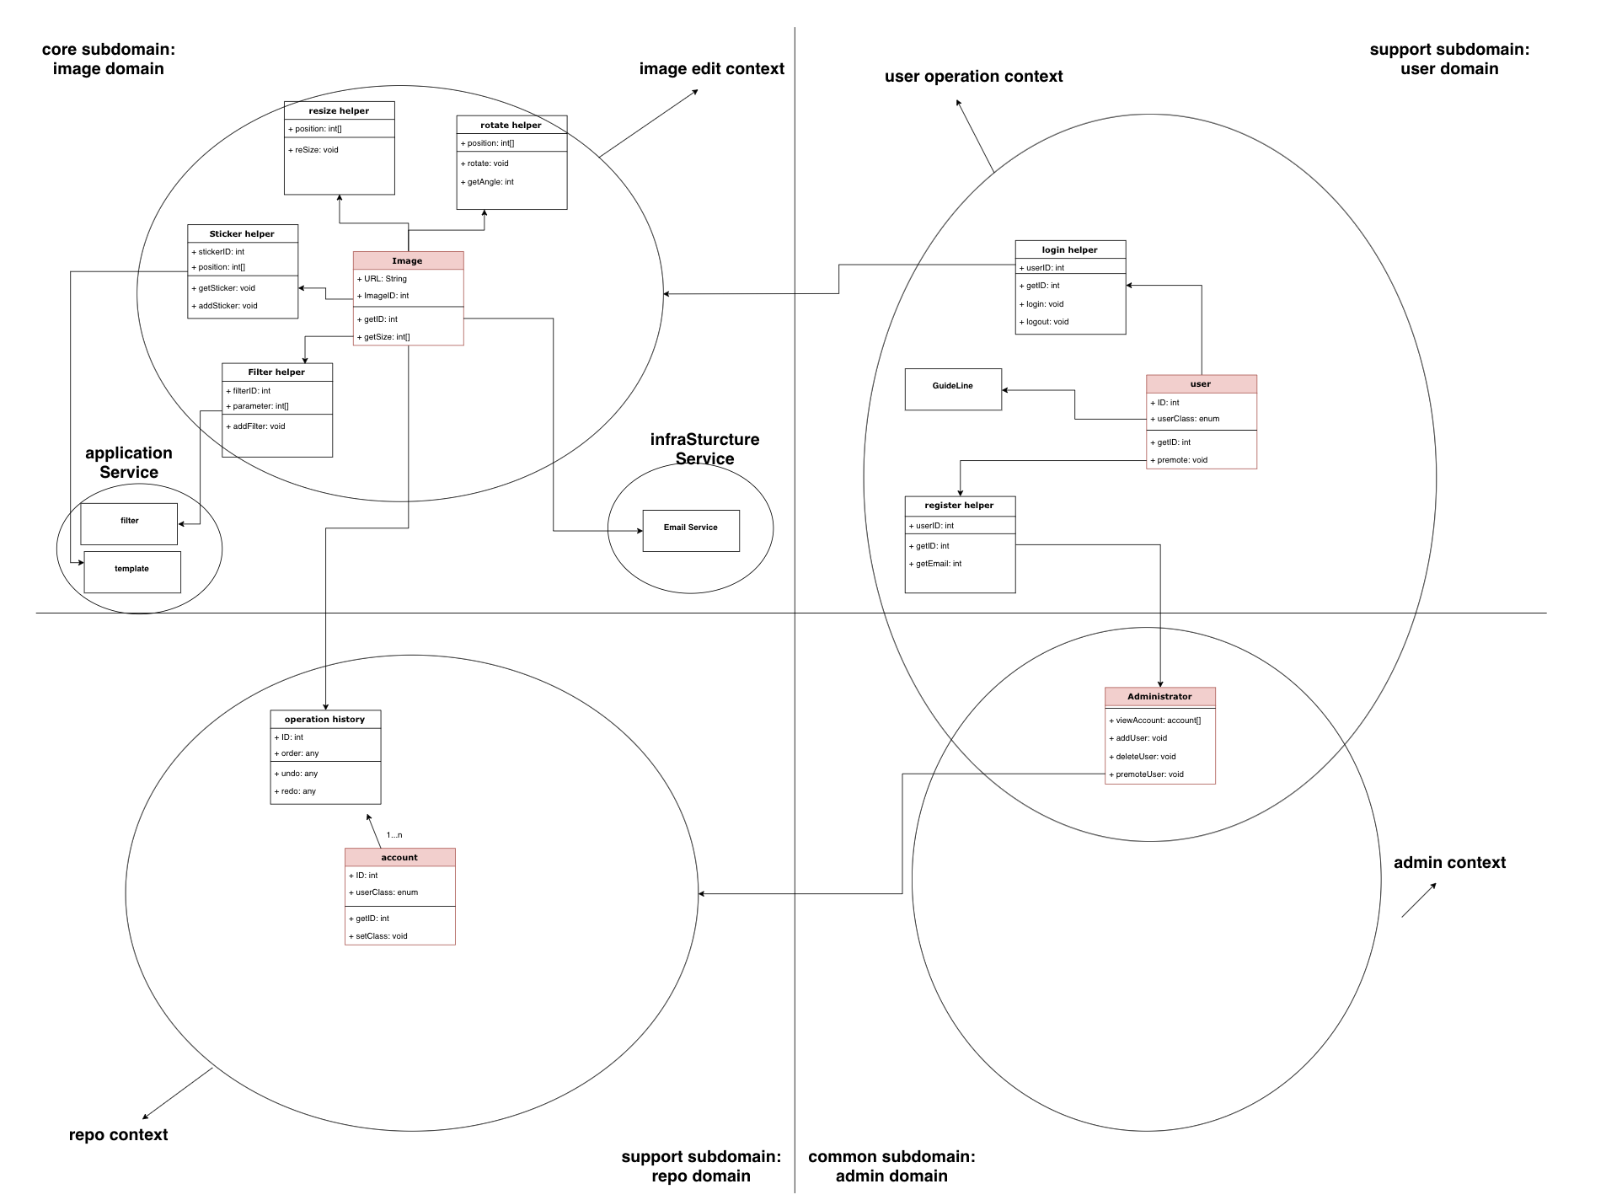
Domain Driven
Design Model

Slide 6
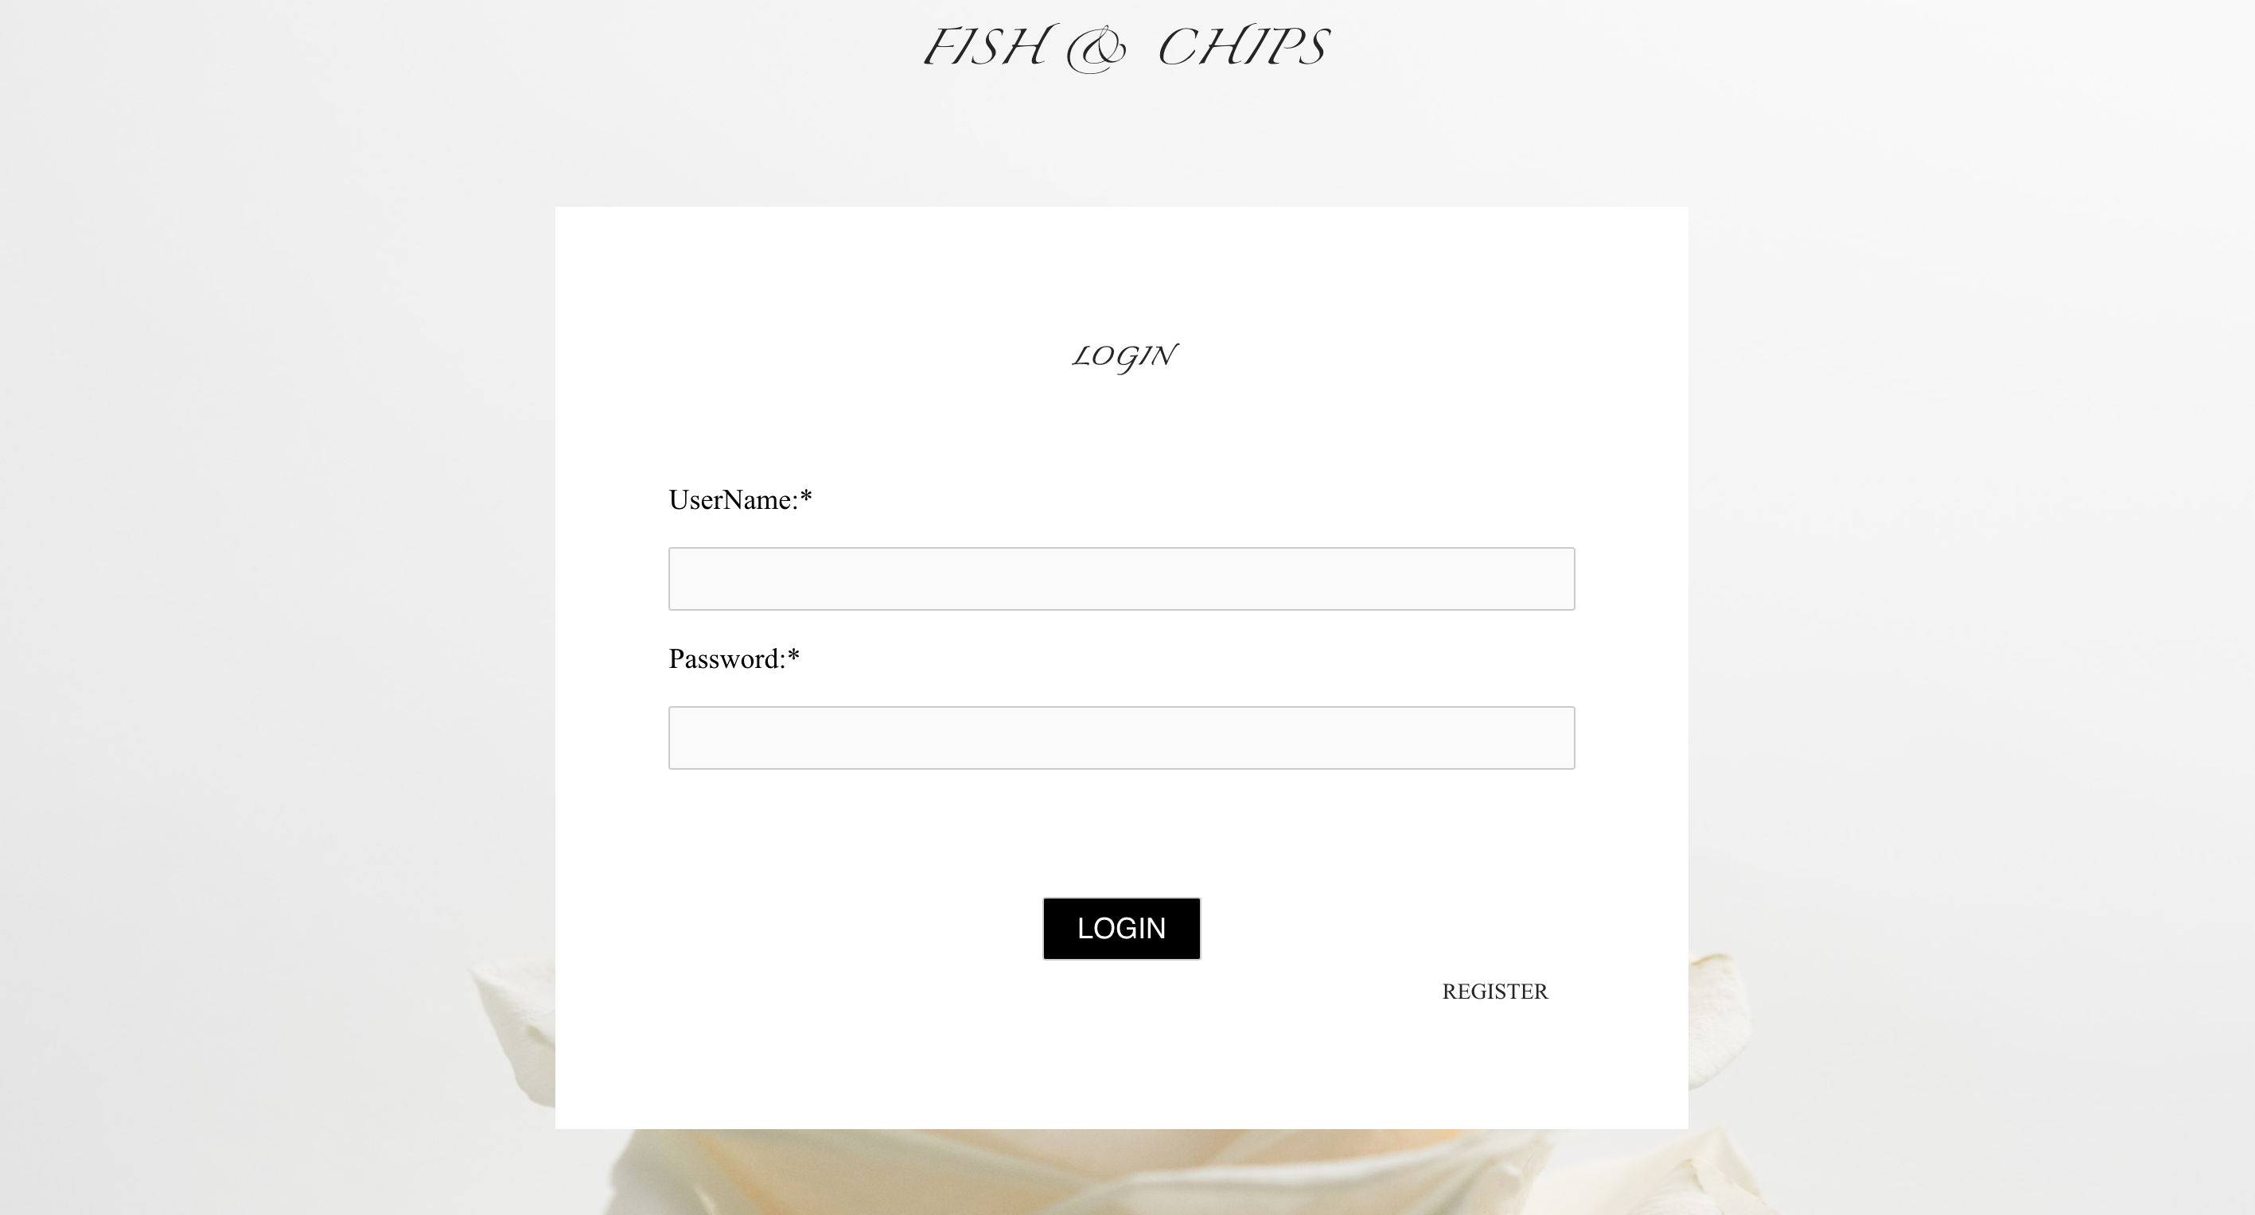
Project takeaways

Slide 7
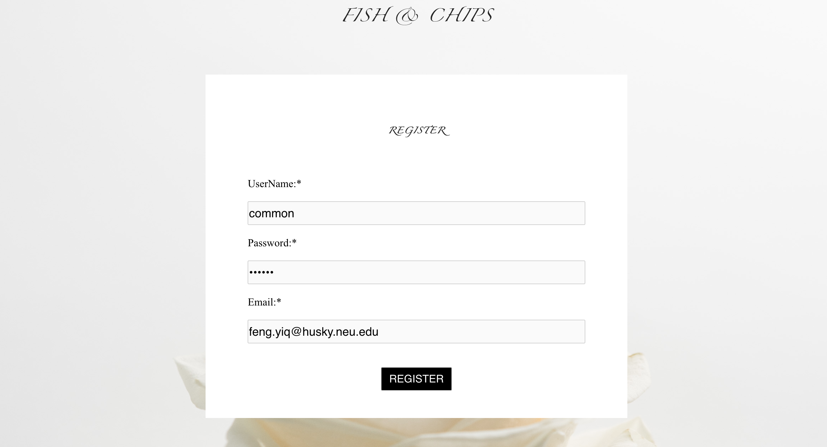
Project takeaways

Slide 8
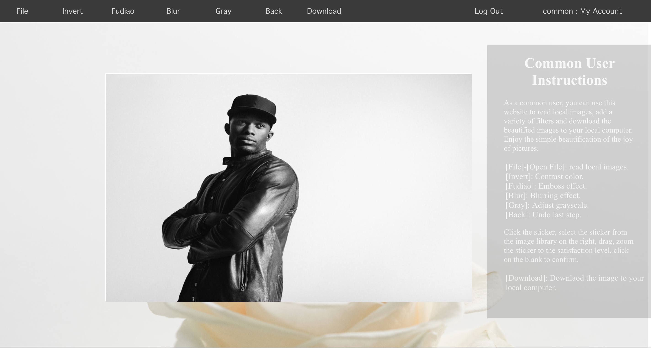
Project takeaways

Slide 9
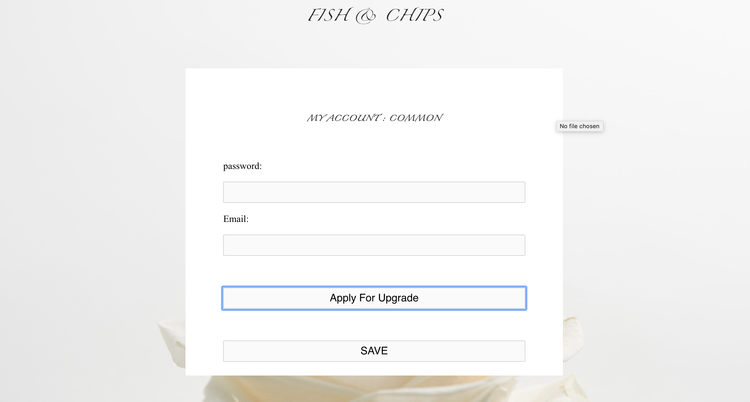
Project takeaways

Slide 10
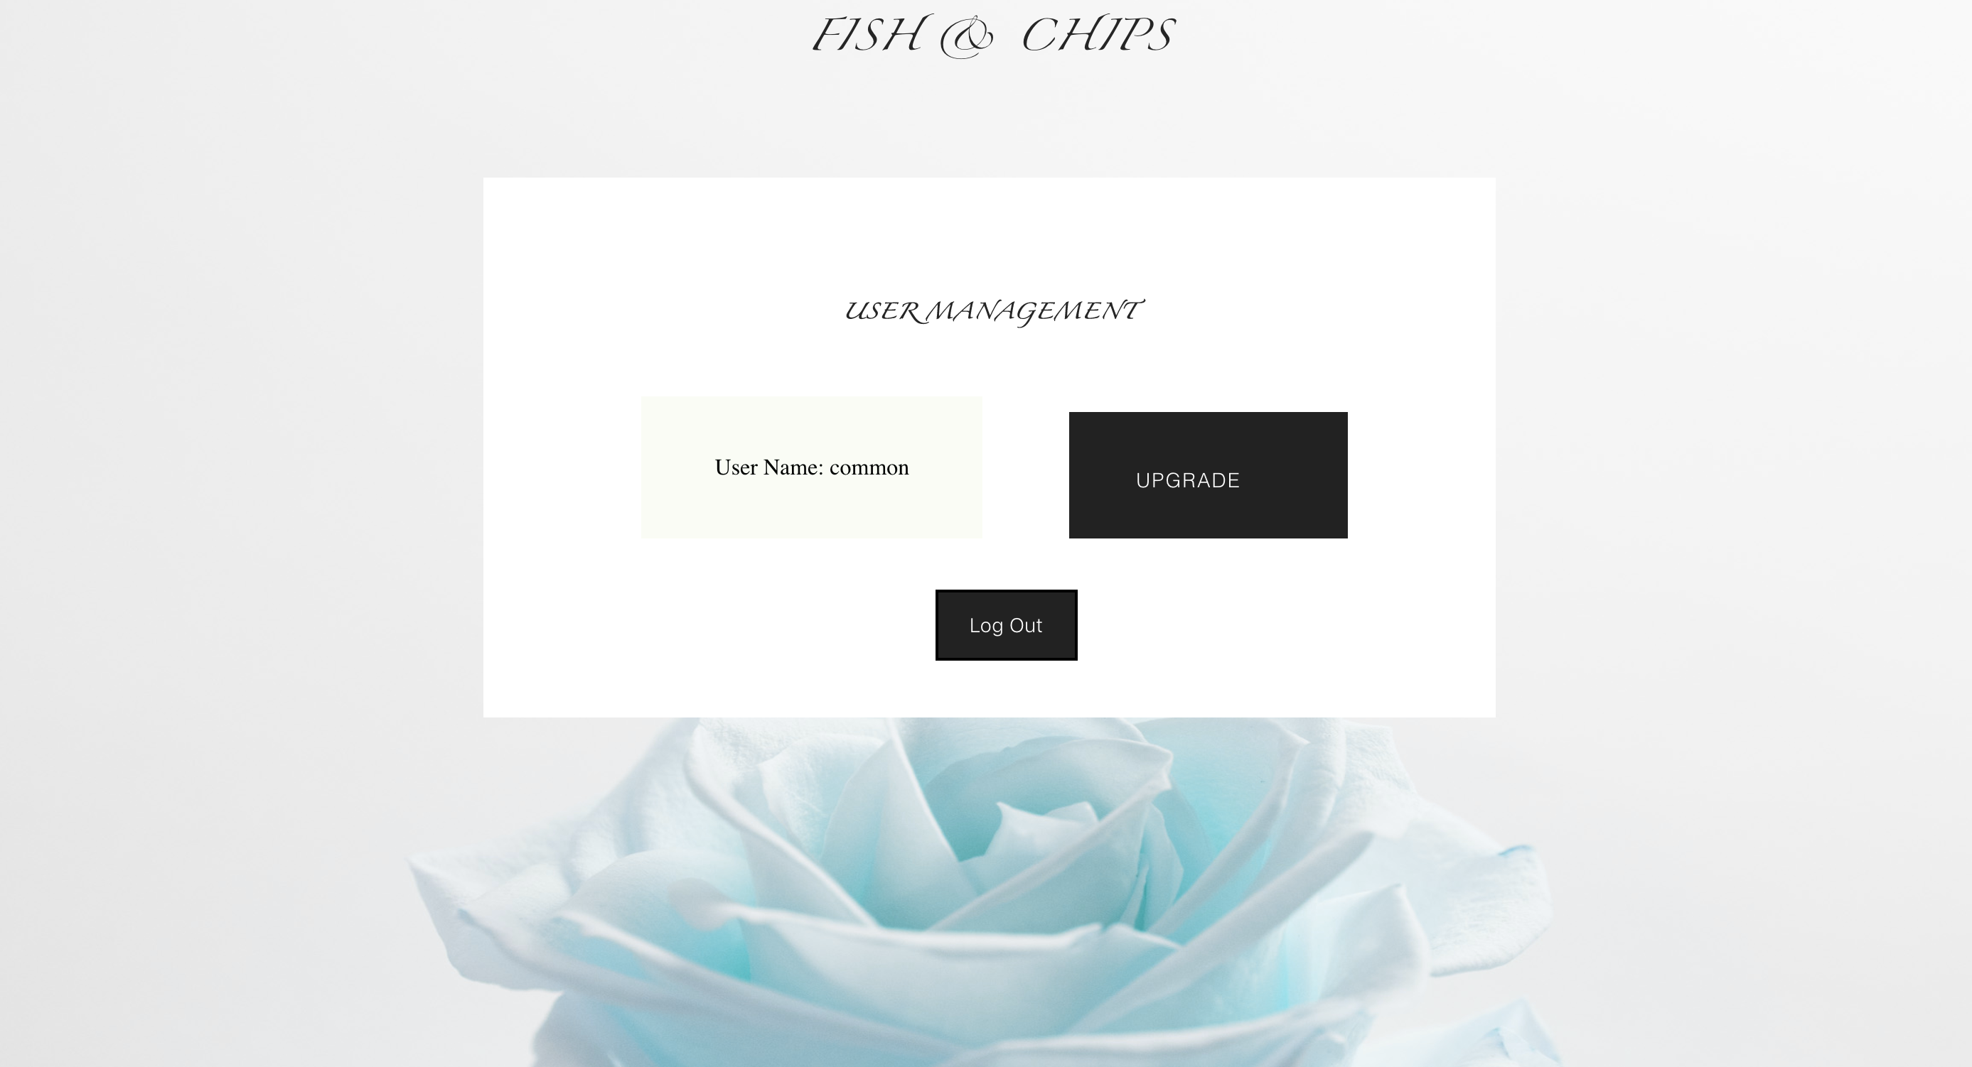
Project takeaways

Slide 11
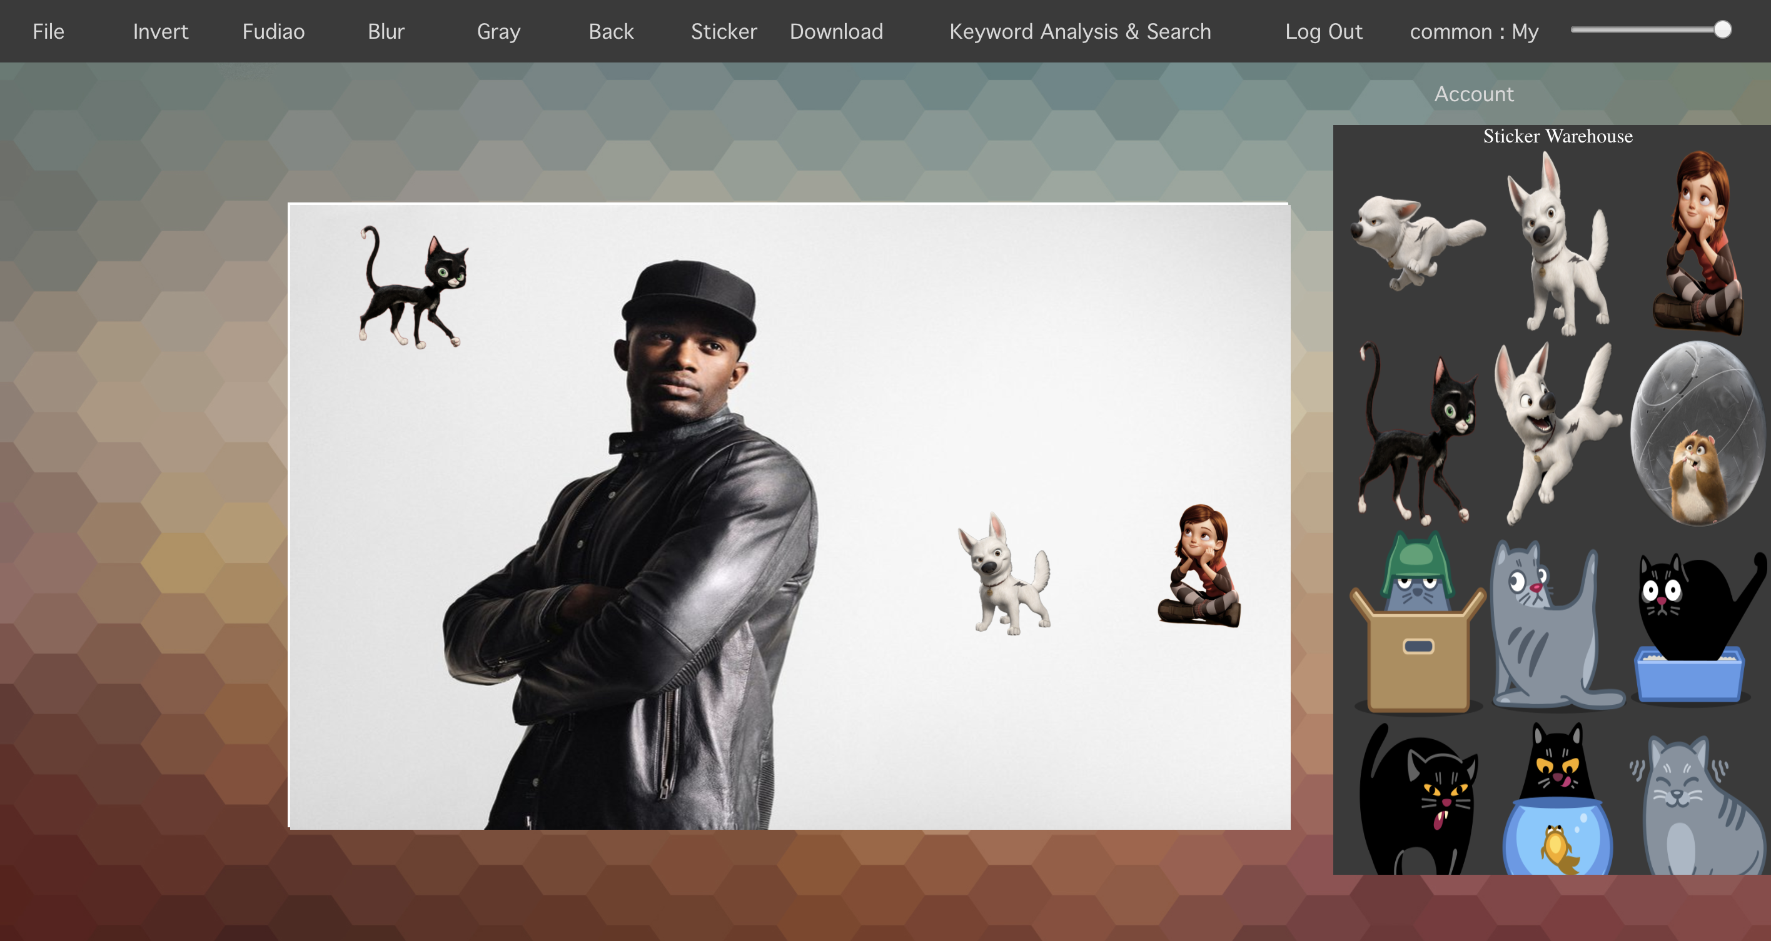
Project takeaways

Slide 12
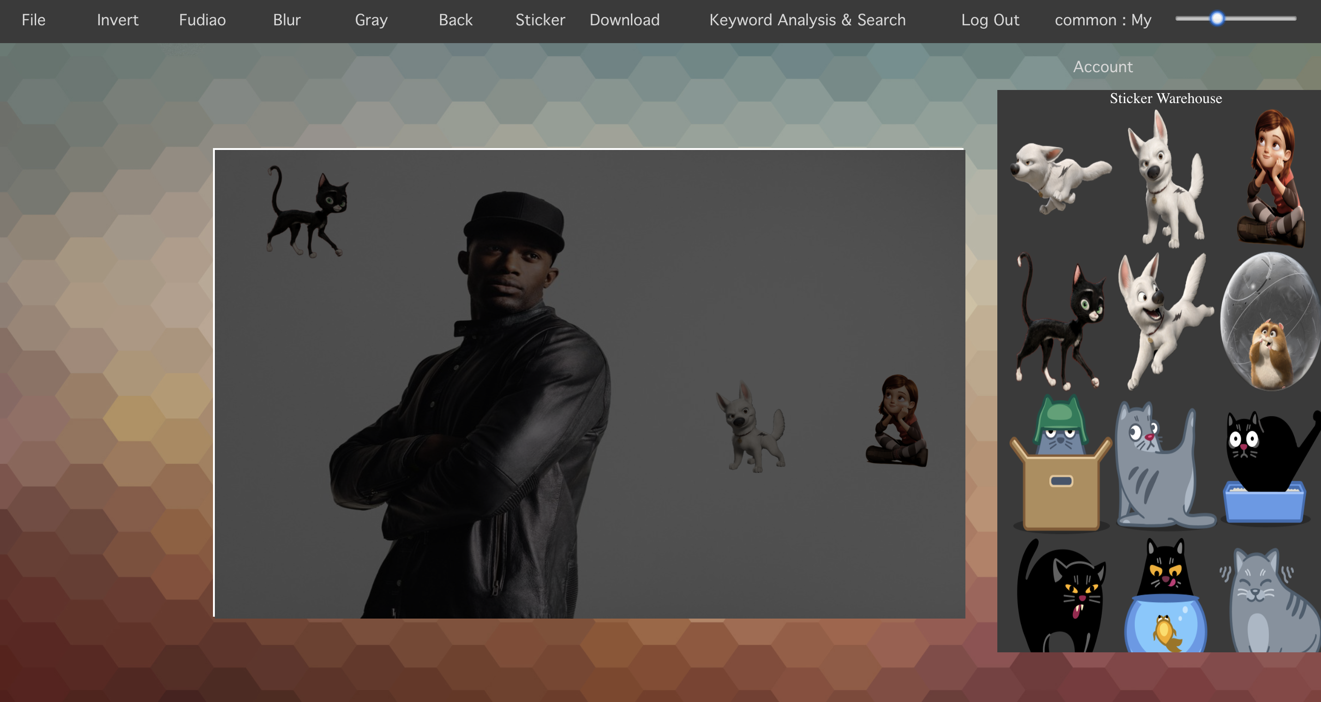
Project takeaways

Slide 13
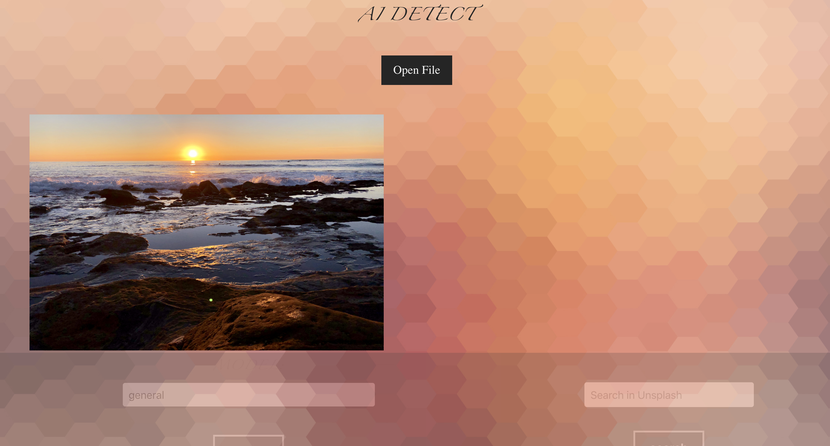
Project takeaways

Slide 14
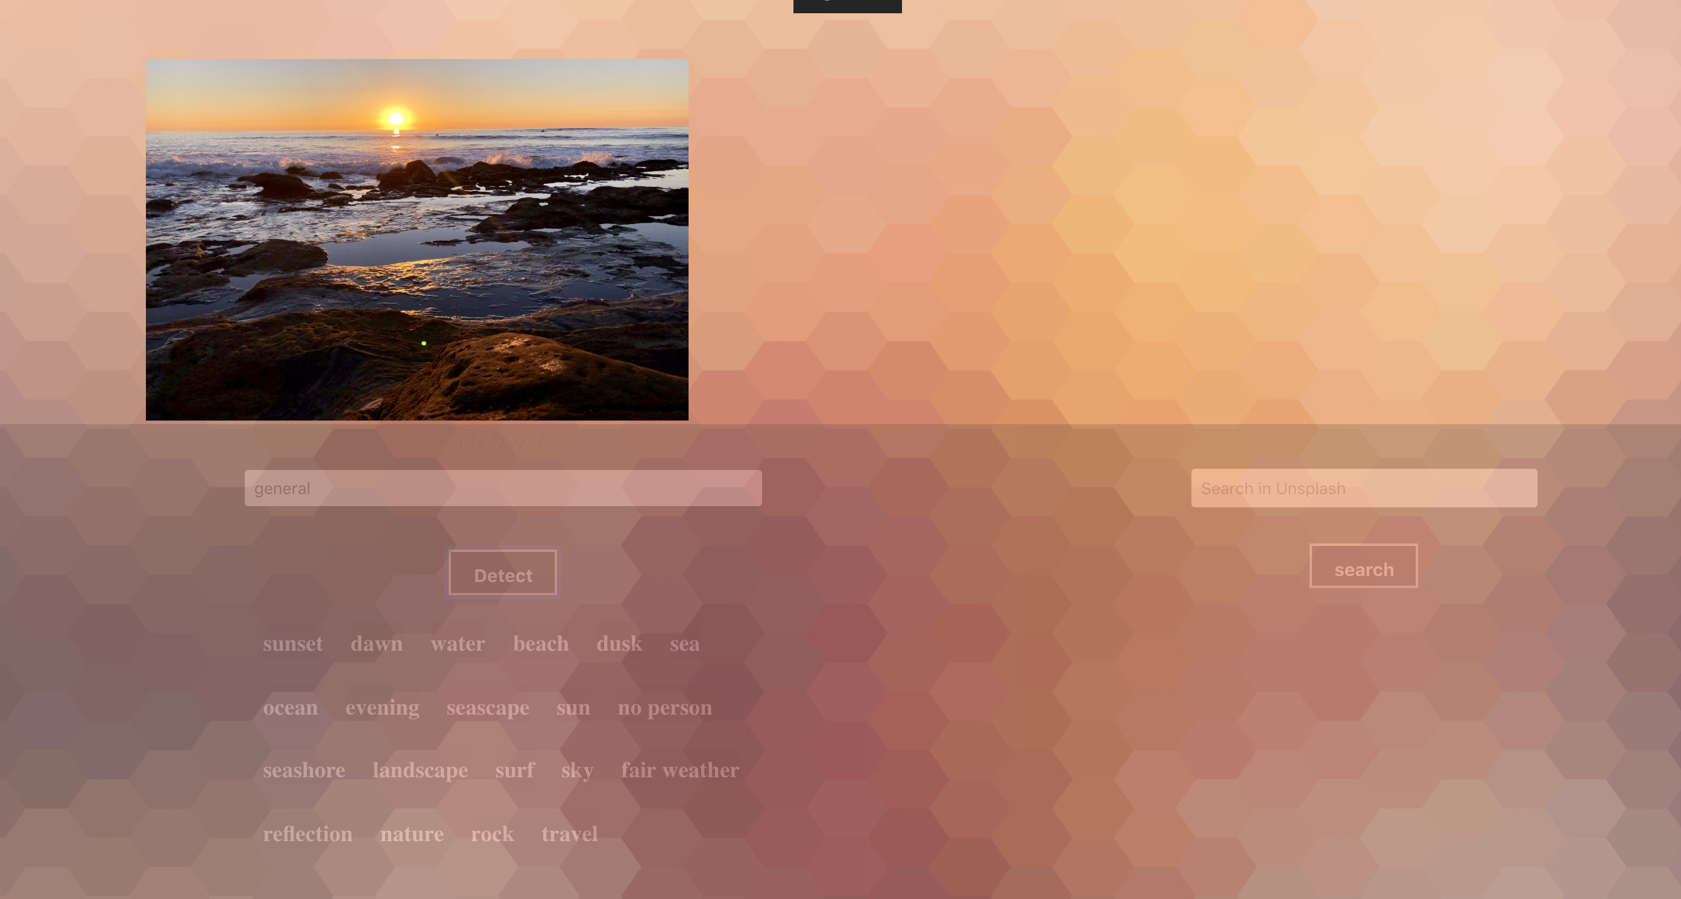
Project takeaways

Slide 15
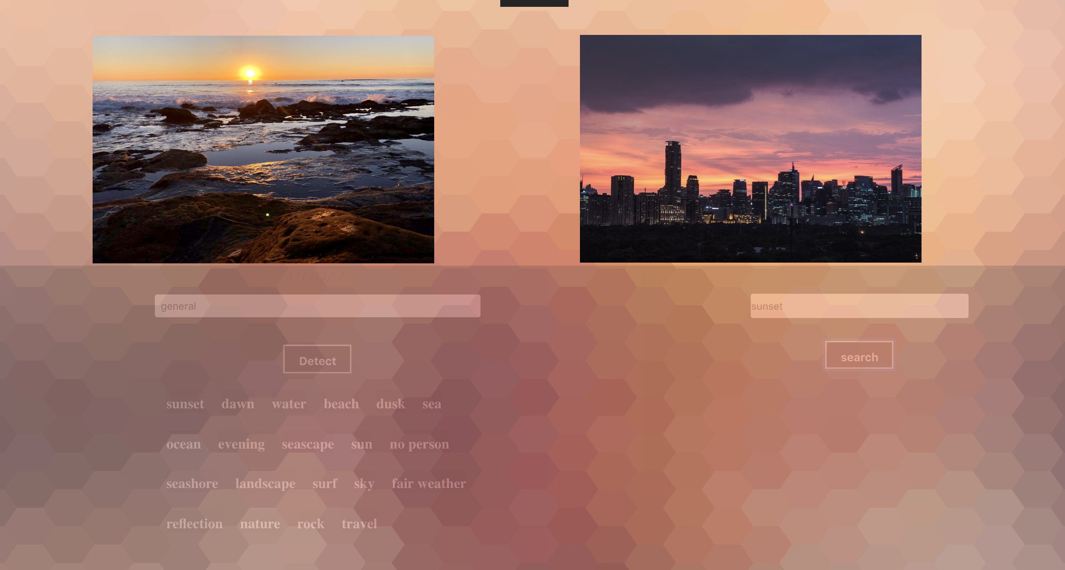
Project takeaways

Slide 16
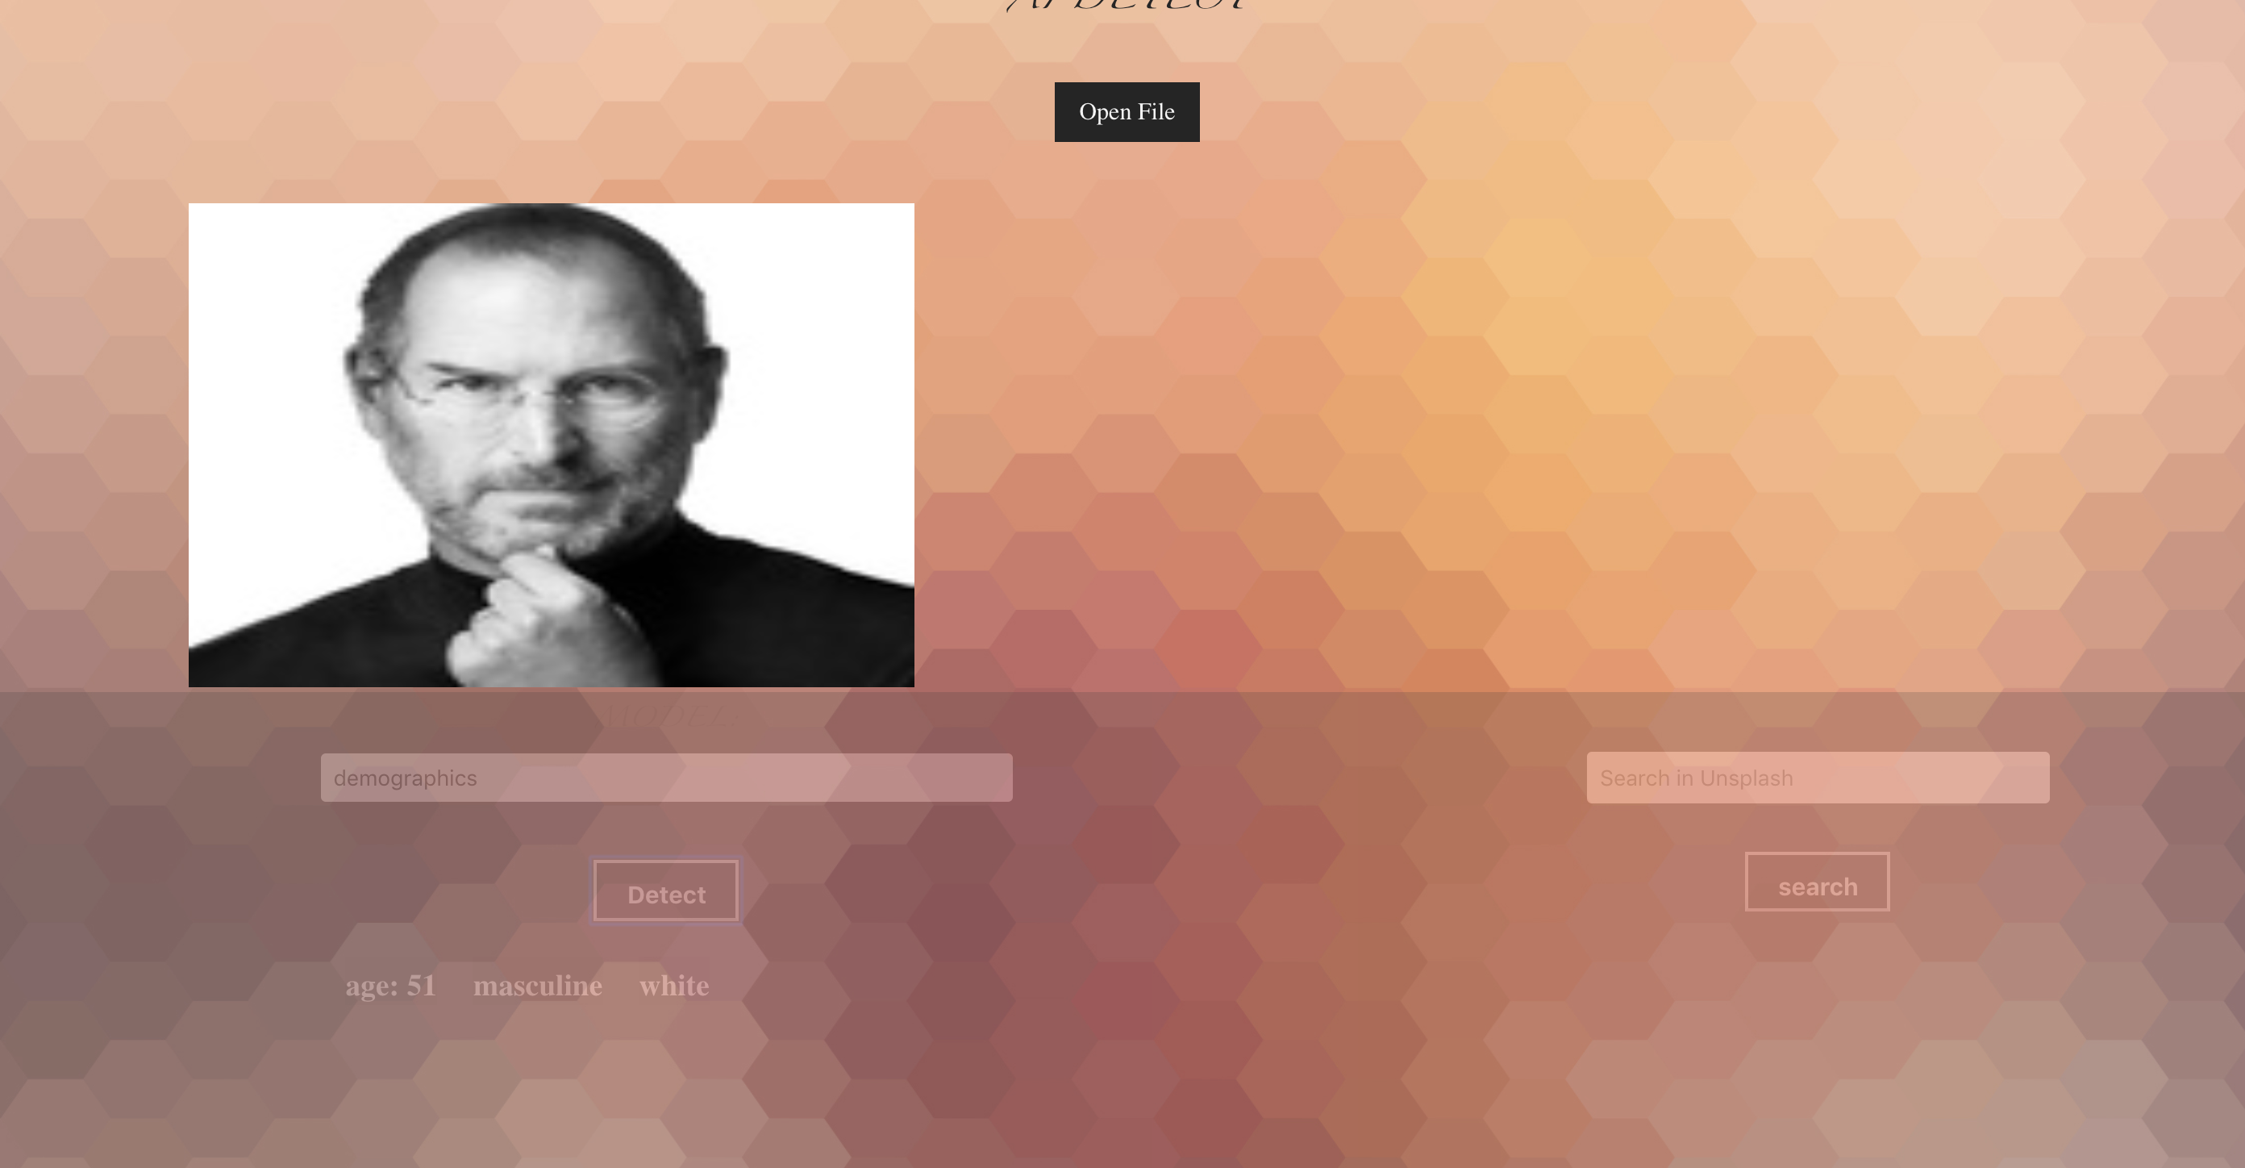
Project takeaways

Slide 17
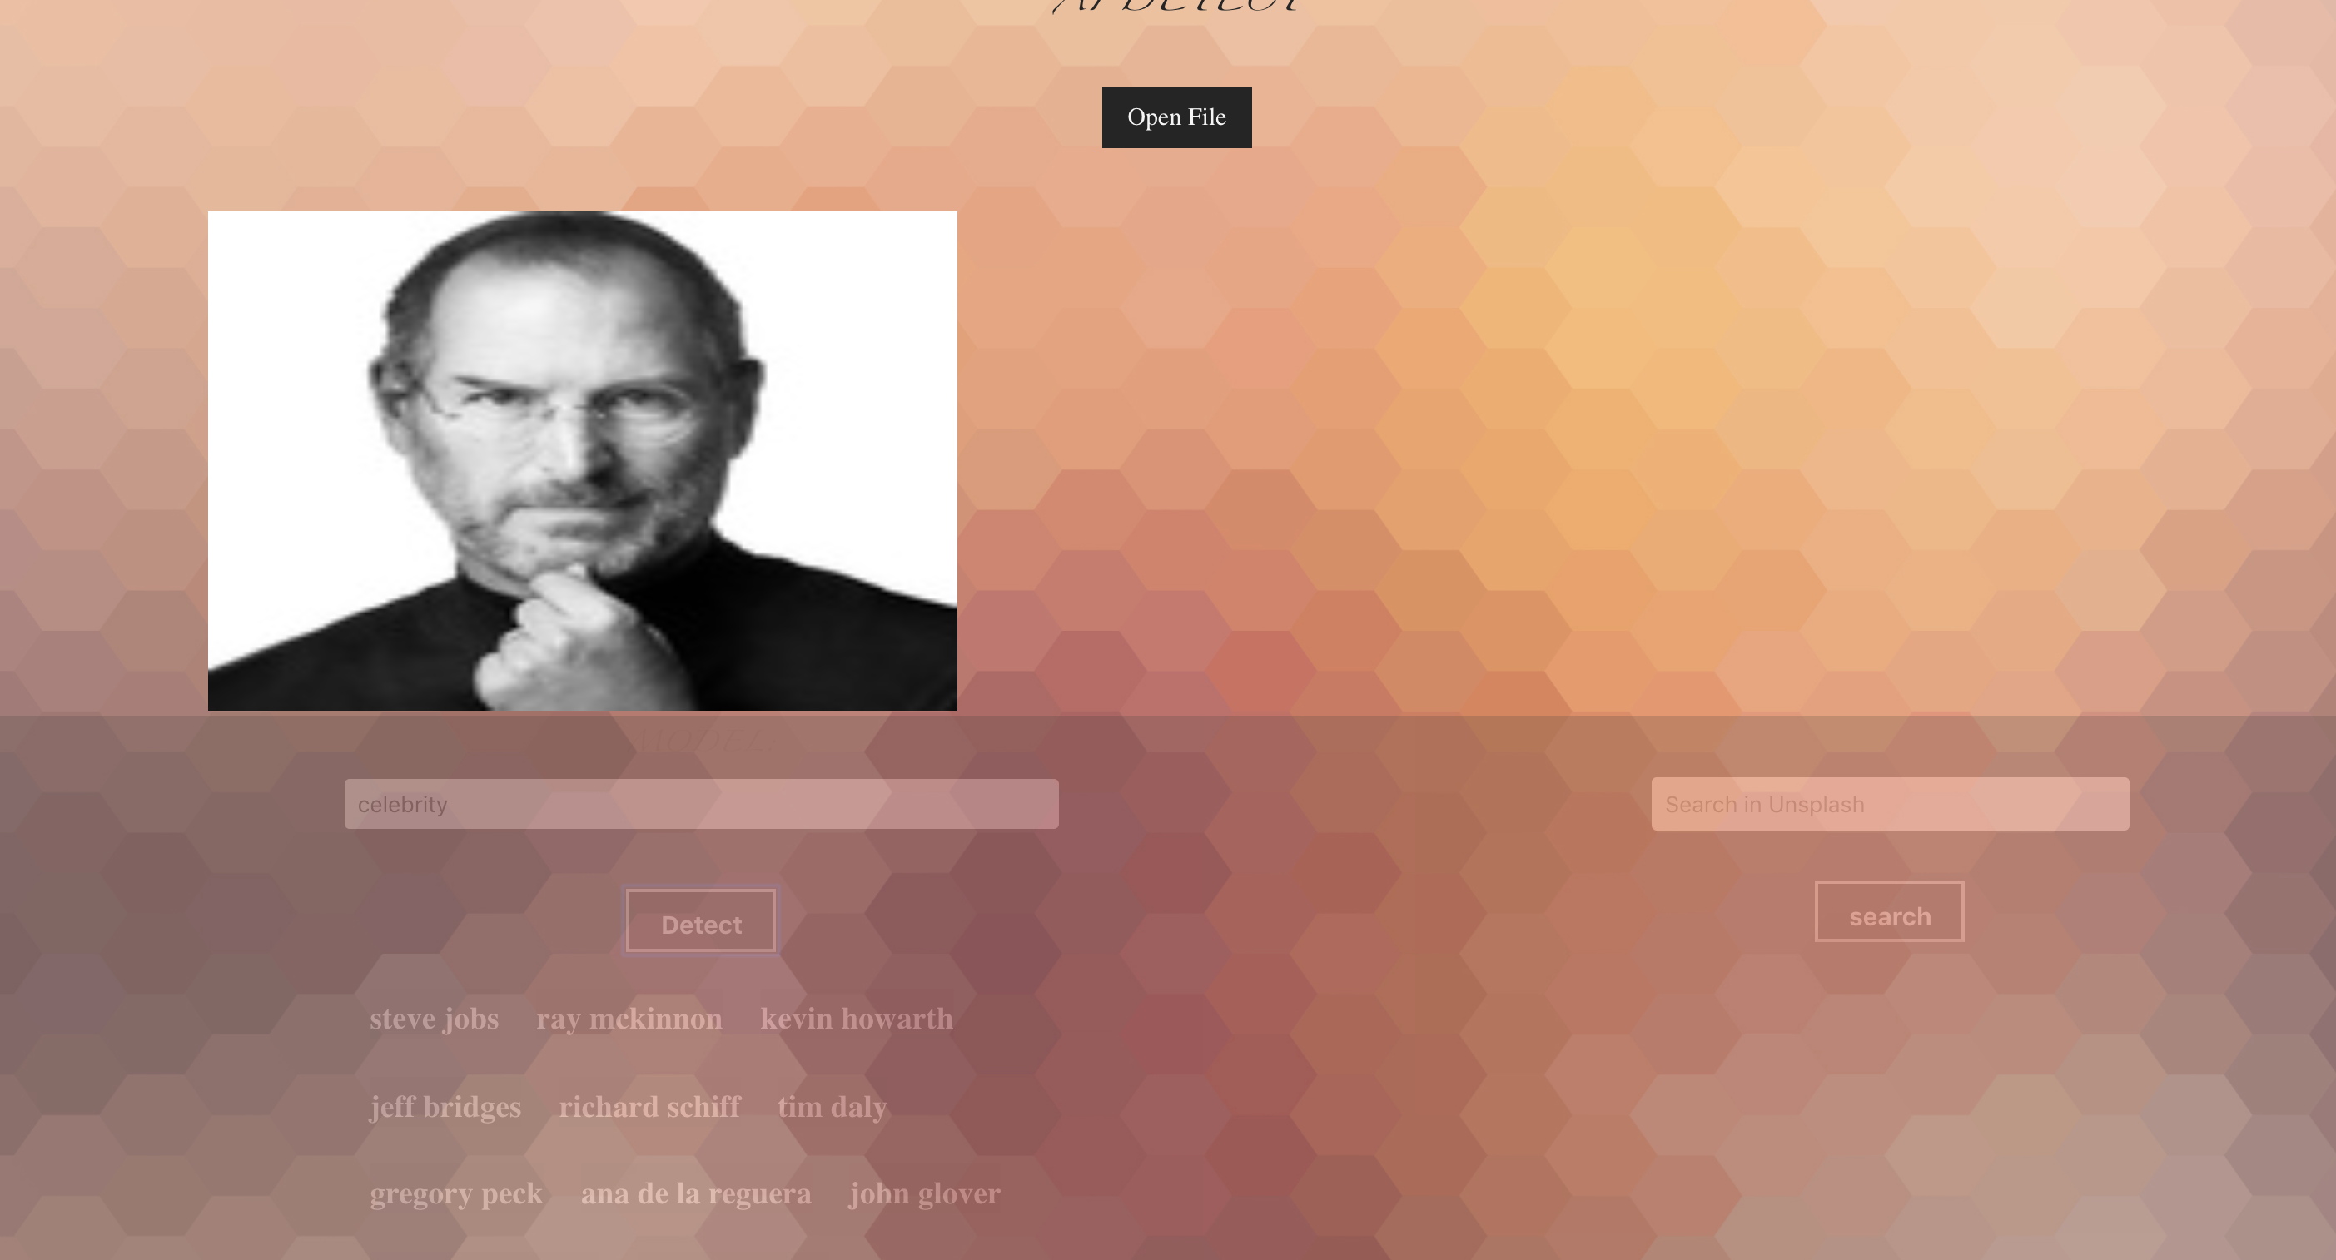
Project takeaways

Slide 18
Thanks!

